Slide 1
CSE477
VLSI Digital Circuits
Fall 2002
Lecture 07: Pass Transistor Logic
Mary Jane Irwin ( www.cse.psu.edu/~mji ) www.cse.psu.edu/~cg477
[Adapted from Rabaey’s Digital Integrated Circuits, ©2002, J. Rabaey et al.]
Notes:
Seating chart updates
Return project proposals with feedback

Slide 2
Review: Static Complementary CMOS
High noise margins
  V_{OH} and V_{OL} are at V_{DD} and GND, respectively
Low output impedance, high input impedance
No static power consumption
  Never a direct path between V_{DD} and GND in steady state
Delay a function of load capacitance and transistor on resistance
Comparable rise and fall times (under the appropriate relative transistor sizing conditions)
V_{DD}
In1
In2
…
PUN
InN
F(In1,In2,…InN)
In1
In2
…
PDN
InN
PUN and PDN are dual logic networks
Notes:
One and only one of the networks (PUN or PDN) is conducting in steady state (output node is always a low-impedance node in steady state)
Why PUN of PMOSs only and PDN of NMOSs only ? (Next next slide)

Slide 3
Review: Static CMOS Full Adder Circuit
!C_{out} = !C_{in} (!A v !B) v !A !B
!Sum = C_{out} (!A v !B v !C_{in}) v !A !B !C_{in}
B
A
B
B
A
B
C_{in}
A
A
C_{in}
!C_{out}
!Sum
C_{in}
A
C_{in}
A
A
B
B
A
B
C_{in}
B
C_{out} = C_{in} (A v B) v A B
Sum = !C_{out} (A v B v C_{in}) v A B C_{in}
Notes:
24 + 4 (for C and Sum inverter) transistor Full Adder
No more than 3 transistors in series
Loads: A-8, B-8, Cin-6, !Cout-2
Number of “gate delays” to Sum – 3?

Slide 4
NMOS Transistors in Series/Parallel
Primary inputs drive both gate and source/drain terminals
NMOS switch closes when the gate input is high
Remember - NMOS transistors pass a strong 0 but a weak 1
A
B
X = Y if A and B
X
Y
A
B
X = Y if A or B
X
Y

Slide 5
PMOS Transistors in Series/Parallel
Primary inputs drive both gate and source/drain terminals
PMOS switch closes when the gate input is low
Remember - PMOS transistors pass a strong 1 but a weak 0
A
B
X = Y if A and B = A + B
X
Y
A
B
X = Y if A or B = A • B
X
Y

Slide 6
Pass Transistor (PT) Logic
B
B
A
A
F
B
B
0
F
0
Gate is static – a low-impedance path exists to both supply rails under all circumstances
N transistors instead of 2N
No static power consumption
Ratioless
Bidirectional (versus undirectional)
Notes:
For class handout

Slide 7
Pass Transistor (PT) Logic
B
B
A
A
F
= A • B
B
B
0
F
= A • B
0
Gate is static – a low-impedance path exists to both supply rails under all circumstances
N transistors instead of 2N
No static power consumption
Ratioless
Bidirectional (versus undirectional)
Notes:
For lecture
what does this implement? (AND gate) how many transistors would it take to implement the same function in static comp CMOS?
at first the switch driven by !B seems to be redundant. It is needed to ensure that a low impedance path exists to the supply rails under all circumstances (when B is low)

Slide 8
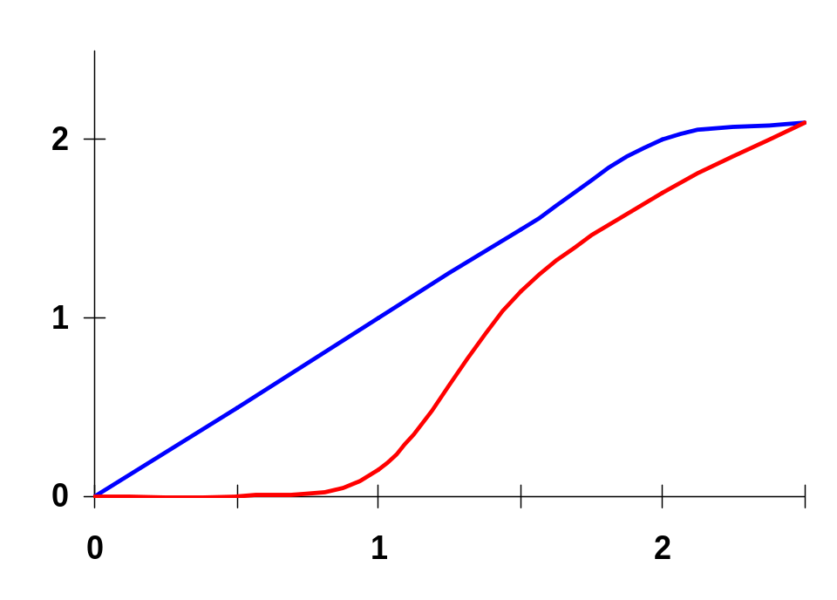
VTC of PT AND Gate
B
1.5/0.25
B=V_{DD}, A=0→V_{DD}
0.5/0.25
V_{out}, V
A
0.5/0.25
B
A=V_{DD}, B=0→V_{DD}
A=B=0→V_{DD}
F
= A•B
0
0.5/0.25
V_{in}, V
Pure PT logic is not regenerative - the signal gradually degrades after passing through a number of PTs (can fix with static CMOS inverter insertion)
Notes:
VTC is data dependent
For blue case – top pass transistor on, bottom off, output follows input A until input is high enough to turn off the top pass transistors (Vdd-Vtn or 2.1 volts in example)
For red case, bottom transistor stays on until the inverter switches to zero (at ~ VDD/2 or 1.25 V). Once the bottom pass transistor turns off, the output follows B minus VTn
Observe that a pure PT gate is not REGENERATIVE. A gradual signal degradation will be observed after passing through a number of subsequent states. Can be remedied by the occasional insertion of a CMOS inverter.

Slide 9
Differential PT Logic (CPL)
A
A
PT Network
B
F
F
B
A
A
Inverse PT Network
F
B
F
B
B
B
B
B
B
B
A
A
A
F=AB
B
F=A+B
A
F=A⊕B
B
A
A
A
F=AB
F=A+B
F=A⊕B
B
B
A
AND/NAND
OR/NOR
XOR/XNOR
Notes:
Question for class - Why not do the same with all pfets??

Slide 10
CPL Properties
Differential so complementary data inputs and outputs are always available (so don’t need extra inverters)
Still static, since the output defining nodes are always tied to V_{DD} or GND through a low resistance path
Design is modular; all gates use the same topology, only the inputs are permuted.
Simple XOR makes it attractive for structures like adders
Fast (assuming number of transistors in series is small)
Additional routing overhead for complementary signals
Still have static power dissipation problems

Slide 11
CPL Full Adder
B
B
C_{in}
C_{in}
A
!Sum
A
Sum
B
B
C_{in}
C_{in}
A
!C_{out}
B
C_{in}
A
C_{out}
B
C_{in}
Notes:
For class handout

Slide 12
CPL Full Adder
B
B
C_{in}
C_{in}
A
!Sum
A
Sum
B
B
C_{in}
C_{in}
A
!C_{out}
B
C_{in}
A
C_{out}
B
C_{in}
Notes:
20 + 4*2 = 28 transistors
color coded with CPL logic slide
problems with (more than one) threshold drops due to chaining CPL blocks

Slide 13
NMOS Only PT Driving an Inverter
In = V_{DD}
V_{x} = V_{DD}-V_{Tn}
V_{GS}
M₂
A = V_{DD}
D
S
B
M₁
V_{x} does not pull up to V_{DD}, but V_{DD} – V_{Tn}
Threshold voltage drop causes static power consumption (M₂ may be weakly conducting forming a path from V_{DD} to GND)
Notice V_{Tn} increases of pass transistor due to body effect (V_{SB})
Notes:
situation is worsened by the body effect since there is SIGNIFICANT source to body voltage when pulling high since the body is tied to GND and the source charges up to VDD

Slide 14
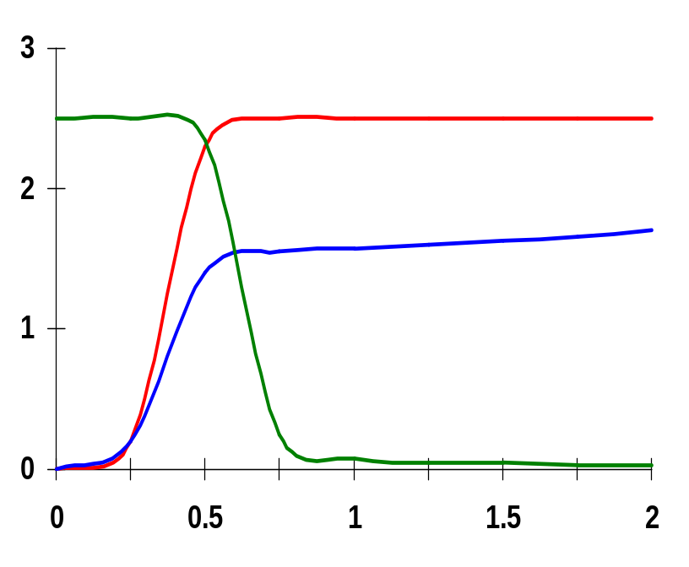
Voltage Swing of PT Driving an Inverter
In
In = 0 → V_{DD}
1.5/0.25
x = 1.8V
D
S
x
V_{DD}
Out
Voltage, V
0.5/0.25
B
0.5/0.25
Out
Time, ns
Body effect – large V_{SB} at x - when pulling high (B is tied to GND and S charged up close to V_{DD})
So the voltage drop is even worse
V_{x} = V_{DD} - (V_{Tn0} + γ(√(|2φ_{f}| + V_{x}) - √|2φ_{f}|))
Notes:
situation is worsened by the body effect since there is significant source to body voltage when pulling high since the body is tied to GND and the source charges up to VDD

Slide 15
Cascaded NMOS Only PTs
B = V_{DD}
B = V_{DD}
C = V_{DD}
G
x
y
A = V_{DD}
M₁
M₂
Out
A = V_{DD}
M₁
x = V_{DD} - V_{Tn1}
S
G
y
Out
C = V_{DD}
M₂
S
Swing on y = V_{DD} - V_{Tn1} - V_{Tn2}
Swing on y = V_{DD} - V_{Tn1}
Pass transistor gates should never be cascaded as on the left
Logic on the right suffers from static power dissipation and reduced noise margins
Notes:
what if C (on right) is VDD-Vtn?

Slide 16
Solution 1: Level Restorer
Level Restorer
on
M_{r}
B
off
A=1
M₂
Out=0
x
= 0
A=0
M_{n}
Out
=1
1
M₁
Full swing on x (due to Level Restorer) so no static power consumption by inverter
No static backward current path through Level Restorer and PT since Restorer is only active when A is high
For correct operation M_{r} must be sized correctly (ratioed)
Notes:
What is it doing while B is zero?
if x was zero (CL discharged), Out stays at 1 through M1 - stable
if x was 1 (CL charged), Out stays at 0 through M2 and holds Mr on keeping CL charged - stable!
Why ratioed – when node x is going from high to low the pull-down network through Mn must be stronger than the pull-up network of Mr in order to switch node x. When Rr is too small, it is impossible to bring the voltage at node x below the switching threshold of the inverter (a function of R1 and R2).

Slide 17
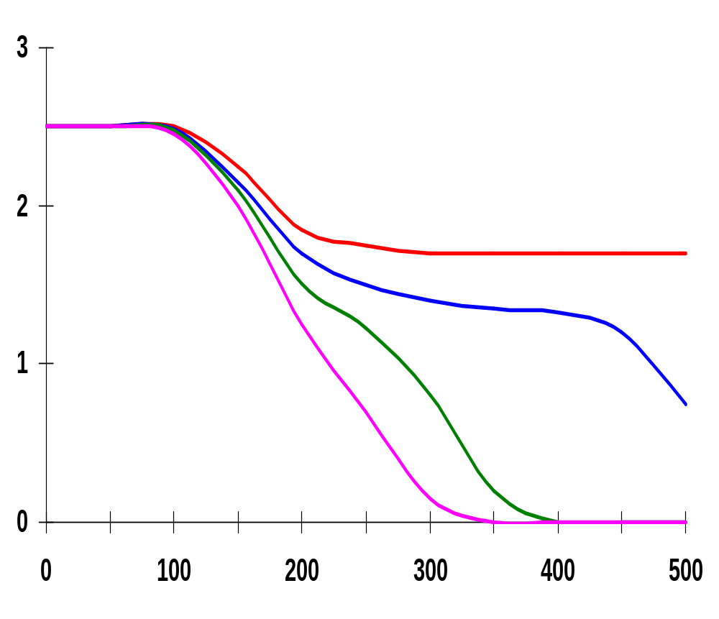
Transient Level Restorer Circuit Response
W/L₂=1.50/0.25
W/L_{n}=0.50/0.25
W/L₁=0.50/0.25
node x never goes below V_{M} of inverter so output never switches
W/L_{r}=1.75/0.25
Voltage, V
W/L_{r}=1.50/0.25
W/L_{r}=1.25/0.25
W/L_{r}=1.0/0.25
Time, ps
Restorer has speed and power impacts: increases the capacitance at x, slowing down the gate; increases t_{r} (but decreases t_{f})
Notes:
Pull down must be stronger than restorer (pull up) to switch node X
If resistance of restorer transistor is too small (too wide transistor) it is impossible to bring the voltage at node x below the switching threshold of the inverter, and the inverter never switches!
Sizing of Mr is critical for DC functionality, not just performance!!
Dynamic, but haven’t covered that yet (see L8 and L9)

Slide 18
Solution 2: Multiple V_{T} Transistors
Technology solution: Use (near) zero V_{T} devices for the NMOS PTs to eliminate most of the threshold drop (body effect still in force preventing full swing to V_{DD})
low V_{T} transistors
In₂ = 0V
A = 2.5V
on
Out
off but leaking
In₁ = 2.5V
B = 0V
sneak path
Impacts static power consumption due to subthreshold currents flowing through the PTs (even if V_{GS} is below V_{T})

Slide 19
Solution 3: Transmission Gates (TGs)
Most widely used solution
C
C
A
B
A
B
C
C
C = GND
C = GND
A = V_{DD}
B
A = GND
B
C = V_{DD}
C = V_{DD}
Full swing bidirectional switch controlled by the gate signal C, A = B if C = 1
Notes:
For class handout

Slide 20
Solution 3: Transmission Gates (TGs)
Most widely used solution
C
C
A
B
A
B
C
C
C = GND
C = GND
A = V_{DD}
B
A = GND
B
C = V_{DD}
C = V_{DD}
Full swing bidirectional switch controlled by the gate signal C, A = B if C = 1
Notes:
Use the NOMS to pull down and the PMOS to pull up
Sizing - use all minimum size, increasing W/L has no net impact on switching delay (reduces resistance but increases diffusion capacitance)
Also ratioless logic

Slide 21
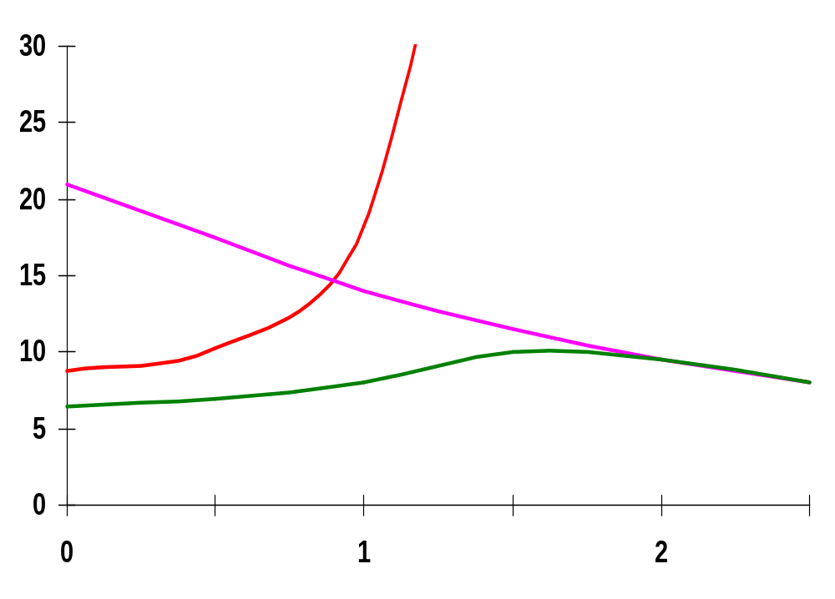
Resistance of TG
W/L_{p}=0.50/0.25
0V
R_{n}
R_{p}
2.5V
V_{out}
R_{p}
R_{n}
Resistance, kΩ
2.5V
R_{eq}
W/L_{n}=0.50/0.25
V_{out}, V
Notes:
Transmission gate is not an ideal switch - series resistance
Effective resistance modeled as parallel connection of Rp and Rn (Rp = (VDD - Vout)/Ip)
For Rn, low values of Vout, in saturation; as Vout increases, resistance increases to infinity (as device shuts off)
For Rp, low values of Vout, in saturation; as Vout approached Vdd, linear mode so resistance decreases.
Req = Rp || Rn is relatively constant ( about 8kohms in this case), so can assume has a constant resistance

Slide 22
TG Multiplexer
S
S
F
S
V_{DD}
In₂
S
F
In₁
S
F = !(In₁ • S + In₂ • S)
GND
In₁
S
S
In₂
Notes:
How does this compare to a static complementary multiplexer (4t in pull down, 4t in pull up), so 2 fewer transistors.
Smaller - probably
Faster?
Cooler?

Slide 23
Transmission Gate XOR
A
A ⊕ B
B
Notes:
For class handout
6 transistor implementation of XOR (versus 10t or 12t for static complementary CMOS)

Slide 24
Transmission Gate XOR
weak 0 if !A
off
on
A • !B
A
A ⊕ B
off
on
B • !A
weak 1 if A
0
B
an inverter
1
Notes:
6 transistor implementation of XOR (versus 10t or 12t for static complementary CMOS)
Note - F always has a connection to VDD or GND, not dynamic so no need to refresh
No voltage drop - obvious with green, for red use transmission gate to ensure no drop

Slide 25
TG Full Adder
C_{in}
B
A
Sum
C_{out}
Notes:
16 transistors – vesterbacke in SiPS99
no more than 2 PT in series, max
full swing - tranmission gates

Slide 26
Differential TG Logic (DPL)
B
A
B
A
B
A
B
A
A
A
F=AB
B
F=A⊕B
GND
B
A
B
GND
V_{DD}
A
A
F=AB
B
F=A⊕B
V_{DD}
A
B
B
AND/NAND
XOR/XNOR

Slide 27
Next Time: The MOS Transistor
MOS transistor dynamic behavior (R and C)
Wire capacitance

Slide 28
Next Lecture and Reminders
Next lecture
  MOS transistor dynamic behavior
    Reading assignment – Rabaey, et al, 3.2.3 & 3.3.3-3.3.5
  Wiring capacitance
    Reading assignment – Rabaey, et al, 4.1-4.3.1
Reminders
  Lecture 5! will be Thursday (guest lecturer)
  Lecture 8 will be on the 24th and lectures 9+10 will be on the 26th
  HW2 due September 24th; HW3 handed out then (due Oct 10th)
  Evening midterm exam scheduled
    Wednesday, October 16th from 8:15 to 10:15pm in 260 Willard
    Only one midterm conflict filed for so far

